Slide 1
Chapter XV
Shadow Mapping
All class materials including this PowerPoint file are available at
https://github.com/medialab-ku/openGLESbook

Slide 2
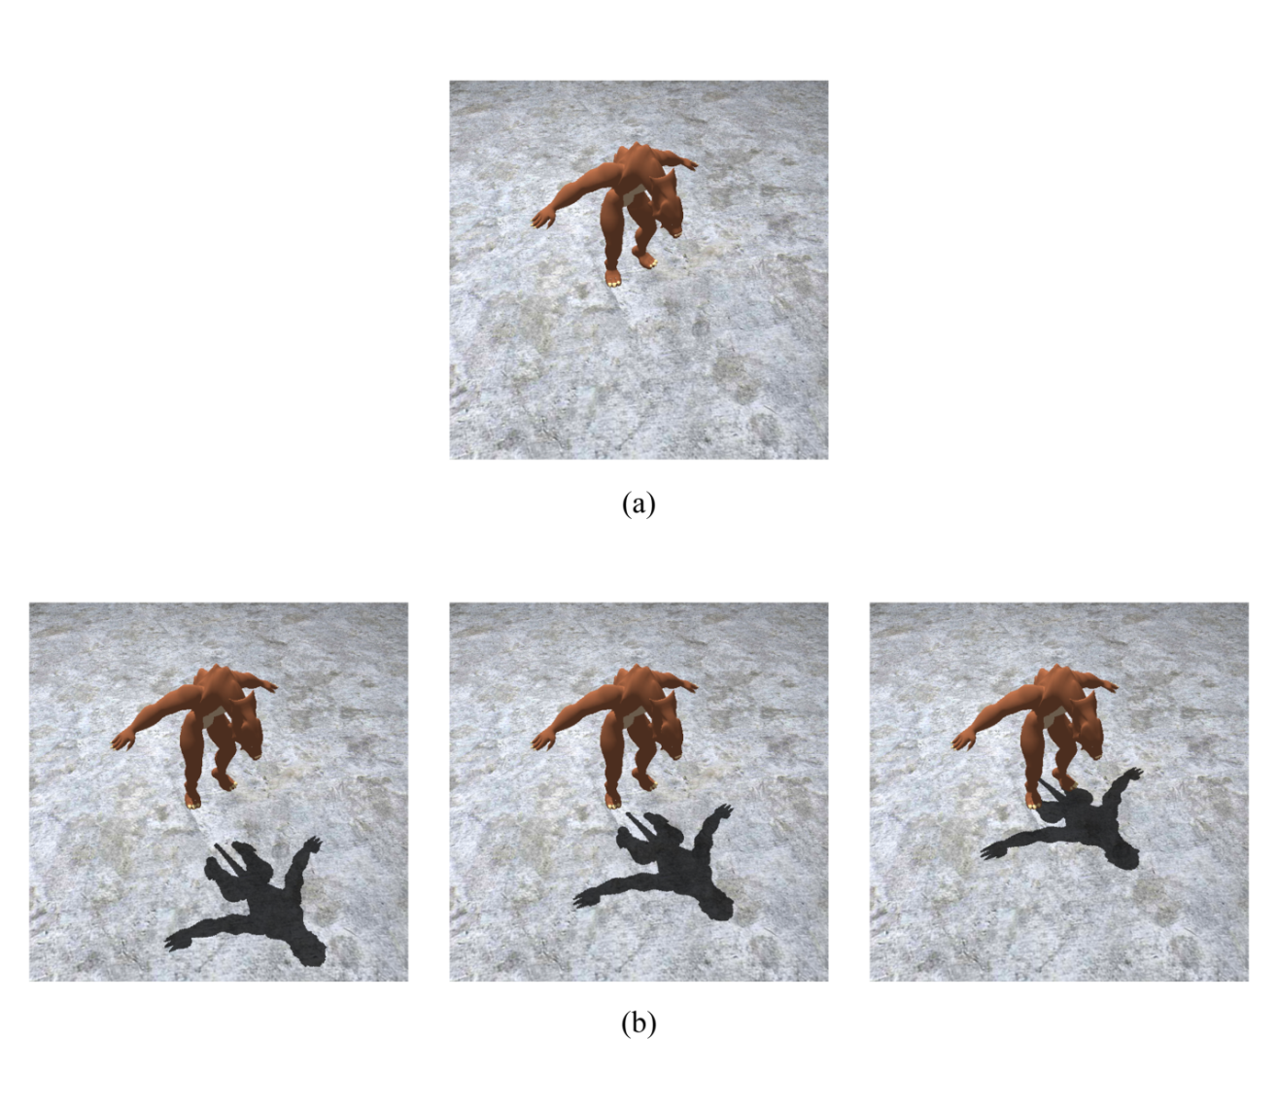
Why Shadows?
Virtually all scenes in the real world have shadows, and therefore shadow generation is an indispensable component in computer graphics.
In addition, shadows help us understand the spatial relationships among objects in a scene.
15-<number>

Slide 3
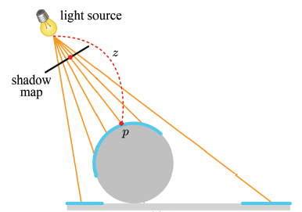
Shadow Mapping
Two-pass algorithm
Pass 1 – not real rendering
  Render the scene from the light source’s viewpoint.
  Store only the depths into the shadow map, which is a depth map with respect to the light source.
15-<number>

Slide 4
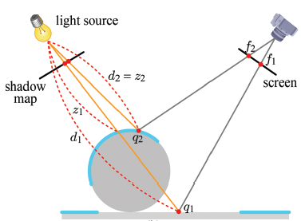
Shadow Mapping (cont’d)
Pass 2 – real rendering
  While rendering the scene from the camera position, compare each fragment’s distance d to the light source with the depth z in the shadow map.
    If d > z, the pixel is in shadows.
    Otherwise, the pixel is lit.
15-<number>

Slide 5
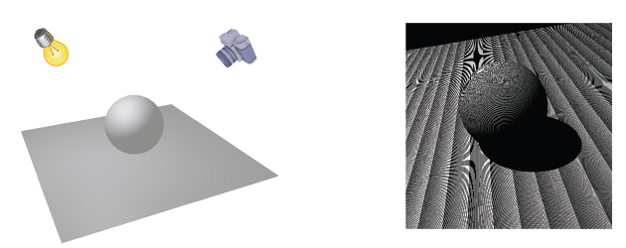
Shadow Mapping – Surface Acne
A brute-force implementation of shadow mapping suffers from the surface acne artifact. The entire scene is decomposed into a number of fractional areas: some are fully lit whereas others are shadowed.
The shadowed and lit pixels coexist on a surface area that should be entirely lit.
15-<number>

Slide 6
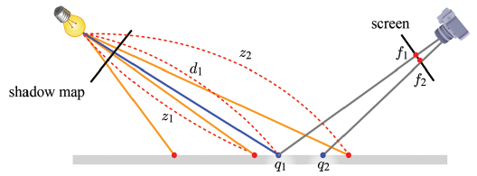
Shadow Mapping – Surface Acne (cont’d)
Note that the scene points sampled at the 2nd pass are usually different from the scene points sampled at the 1st pass.
Suppose the nearest point sampling.
In the example, q₁ is to be lit, but judged to be in shadows because d₁ > z₁. On the other hand, q₂ is to be fully lit. Such a coexistence of shadowed and fully lit pixels leads to the surface acne artifact.
15-<number>

Slide 7
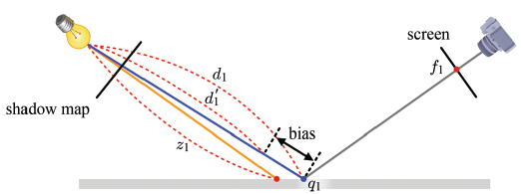
Shadow Mapping – Surface Acne (cont’d)
At the 2nd pass, subtract a small bias value from d₁ such that d₁´ < z₁.
15-<number>

Slide 8
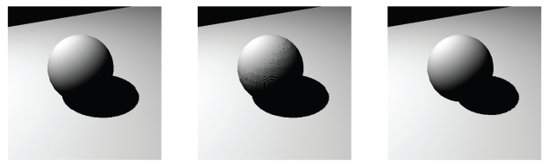
Shadow Mapping – Surface Acne (cont’d)
The bias value is usually fixed after a few trials.
biased shadow mapping too small a bias too large a bias
15-<number>

Slide 9
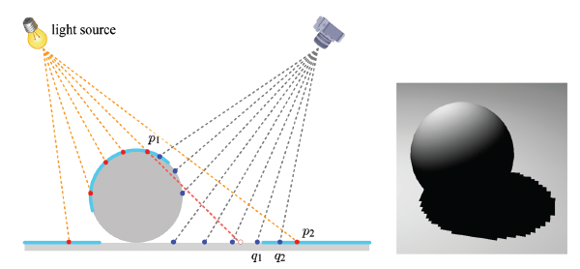
Shadow Map Filtering
If the resolution of a shadow map is not high enough, multiple pixels may be mapped to a single texel of the shadow map.
This is a magnification case. Suppose you choose the nearest point sampling.
A fragment can be either fully lit or shadowed. It has no other option. Then, the shadow boundary usually has a jagged appearance. This is an aliasing artifact.
15-<number>

Slide 10
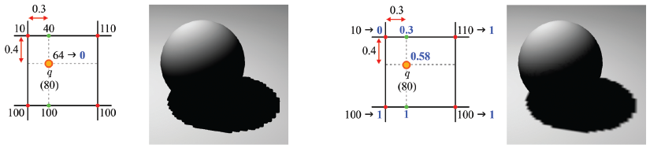
Shadow Map Filtering (cont’d)
Unfortunately, bilinear interpolation doesn’t help: A pixel is either fully lit or fully shadowed and consequently the shadow quality is not improved at all by choosing bilinear interpolation.
A solution to this problem is to first determine the visibilities of a pixel with respect to the four texels, and then interpolate the visibilities. This value is taken as the “degree of being lit.”
The technique of taking multiple texels from the shadow map and blending the pixel's visibilities against the texels is named percentage closer filtering (PCF).
15-<number>

Slide 11
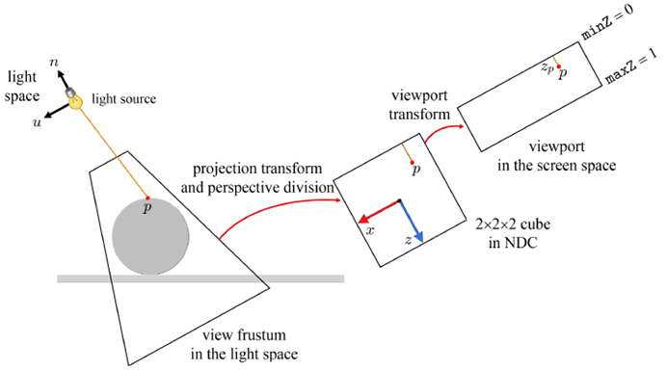
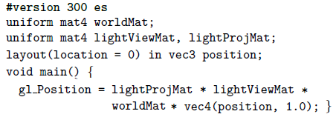
Shadow Mapping - Implementation
Let’s see the first-pass shaders only. The second-pass shaders are a little complicated. See Sections 15.3.2 and 15.3.3, which are optional though.
The view matrix is defined with EYE placed at the light source position. It transforms the world-space vertex into a space, named the light space.
15-<number>

Slide 12

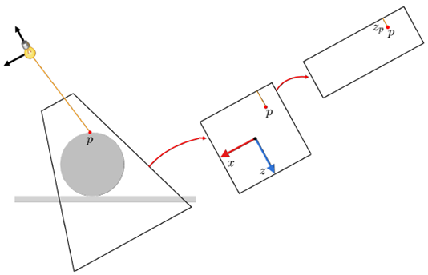


Shadow Mapping – Implementation (cont’d)
Note that there are no attributes to interpolate because the vertex shader outputs nothing except gl_Position. So, nothing to interpolate.
Not surprisingly, the fragment shader’s main function is empty.
The color of a fragment is not returned, but its screen-space coordinates are passed to the output merger so that it goes through z-buffering. The z-buffer is updated so as to contain the depth values of the surfaces visible from the light source. It is the shadow map.
vertex
shader
fragment
shader
15-<number>

Slide 13
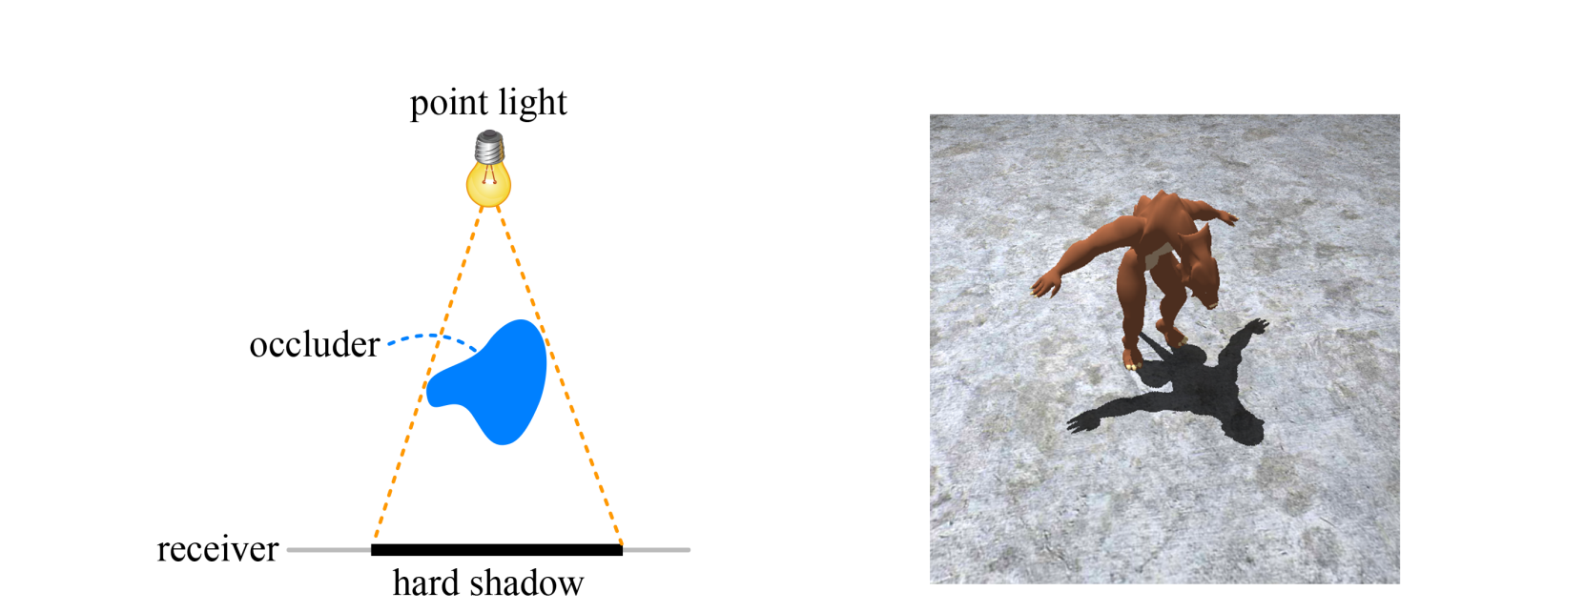
Hard Shadow vs. Soft Shadow
A point light source generates hard shadows.
15-<number>

Slide 14
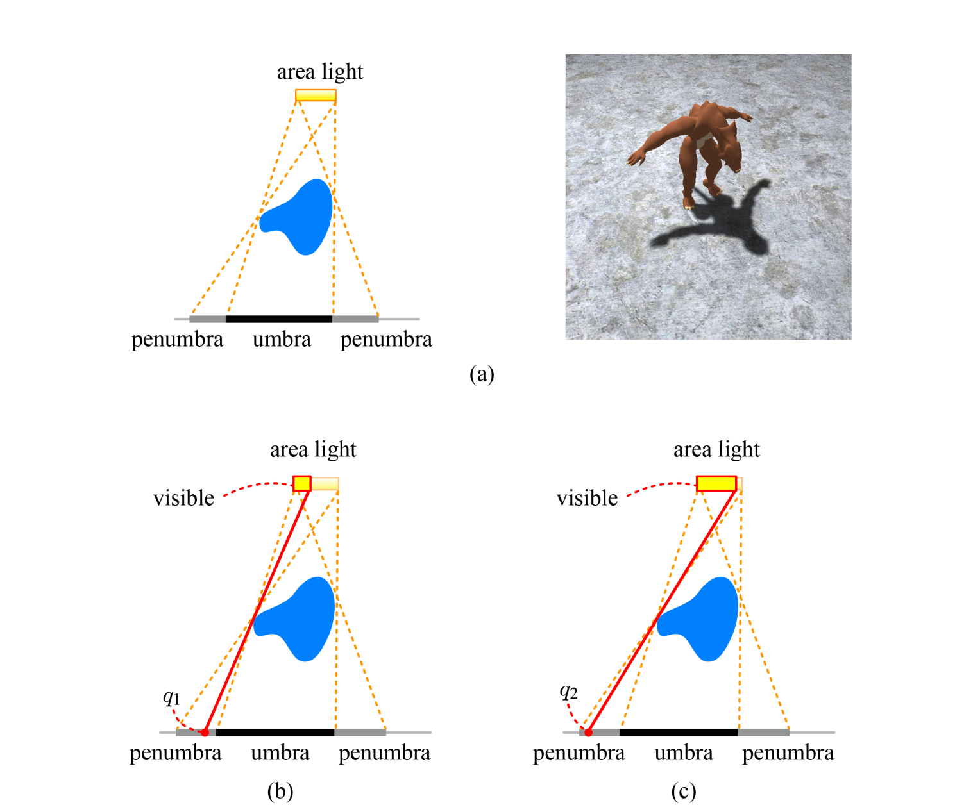
Hard Shadow vs. Soft Shadow (cont’d)
An area or volumetric light source generates soft shadows.
15-<number>

